Slide 1

Capstone Project
Western Countries Financial Data
Presented By : Sunil Kumar Prusty

Slide 2

Introduction
Data Explorer and summarizations
Data Cleaning and Statical Analysis Excel
Graphical analysis and insights using excel
Database setup and SQL Operations
Running Query in SQL.
Data import to power bi from SQL database.
Data Preparation and Visualization in Power BI.
Interactive Dashboard Creation in Power BI.
Conclusion.
Contents

Slide 3
Introduction
Brief Overview of the Data Lifecycle
Begins with data collection from various sources.
Followed by cleaning and preprocessing to ensure accuracy.
Analysis and visualization help uncover patterns and insights.
Final step involves reporting and decision-making based on findings.
Importance of Data Cleaning, Analysis, and Visualization
Ensures data integrity and reliability.
Helps identify trends, outliers, and performance metrics.
Supports strategic decisions with clear, visual evidence.
Tools Used
Excel: For initial data exploration, cleaning, and basic analysis.
SQL: For structured data storage and advanced querying.
Power BI: For dynamic visualizations and interactive dashboards.

Slide 4
DATA EXPLORATION AND SUMMARIZATION
Data Summary
Total Variables: 16
Total Observations: 700
Missing Values:
Discounts: 53 Missing Values
Profit: 5 Missing Values
Duplicate Rows: 0 (No Duplicates)
Column Types:
Categorical Columns: Segment, Country, Product, Discount Band, Month Name
Numerical Columns: 10
Date-Time Column: 1
Variable Overview
Categorical Variables:
Segment (5 unique values),Country (5), Product (6),Discount Band (4).
Numerical Variables:
Units Sold(510), Manufacturing Price(6),Sale Price (7), Gross Sales(550).
Discounts (515) → 53 missing values.
Sales (559), COGS(545),Profit (557) → 5missing values in Profit.
Date-Time Variables:
Date (16 unique values), Month Number (12),Month Name (12),Year (2).

Slide 5
Data Cleaning Steps
Removed Duplicates: All duplicate rows were eliminated.
Date Conversion: Columns with date-like values were converted to proper datetime format.
Missing Values:
Numerical columns: Filled with the median value.
Categorical columns: Filled with the most frequent (mode) value.
Data Type Correction: Ensured all numerical columns are correctly typed.

Slide 6
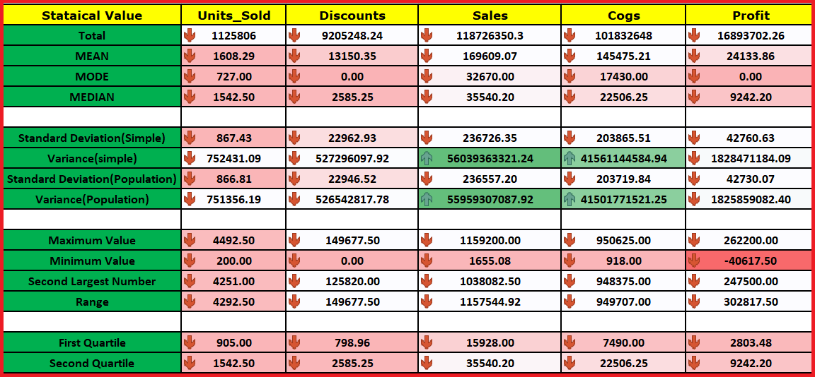
STATISTICAL ANALYSIS IN EXCEL

Slide 7
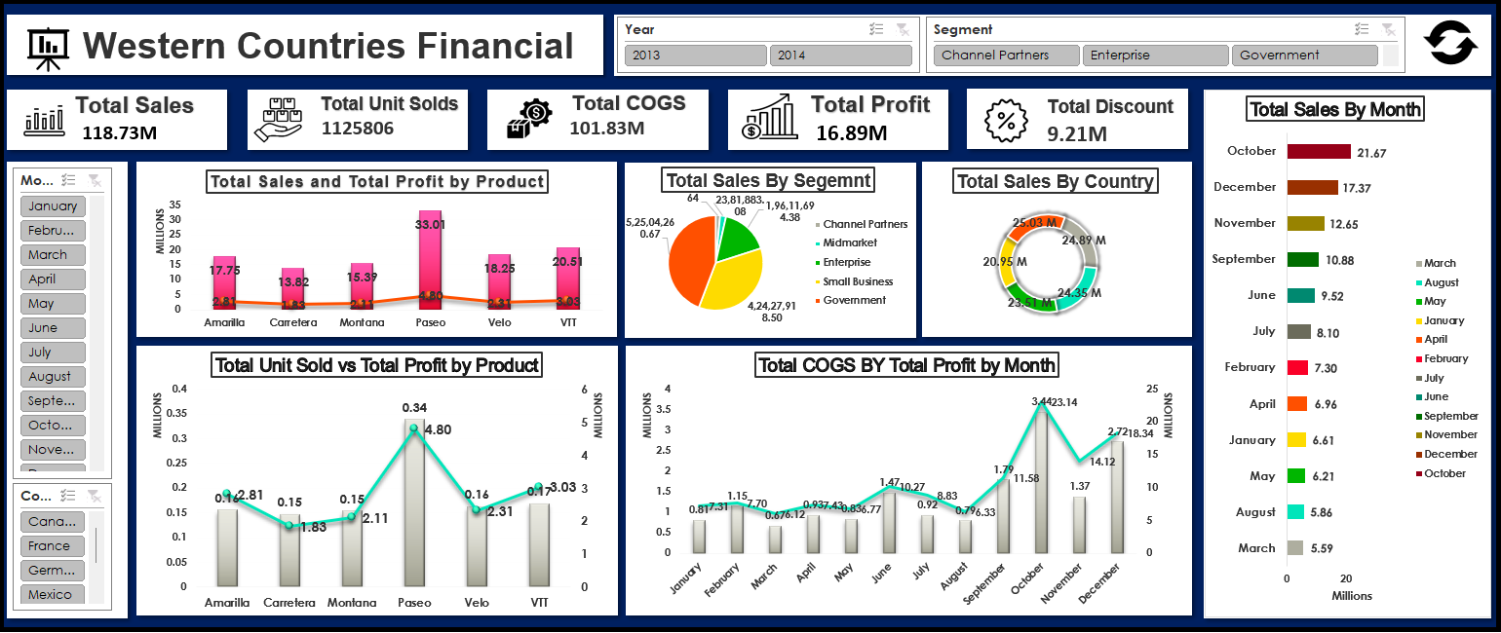
GRAPHICAL ANALYSIS AND INSIGHTS USING EXCEL

Slide 8
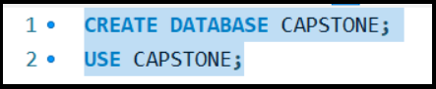
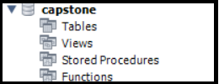
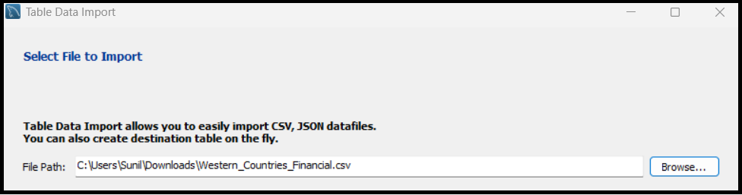
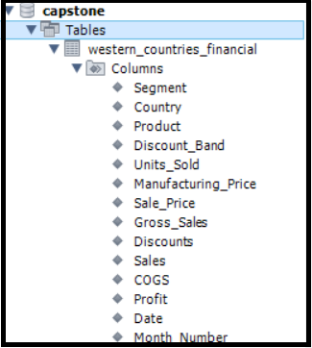
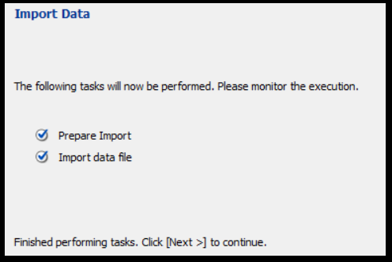
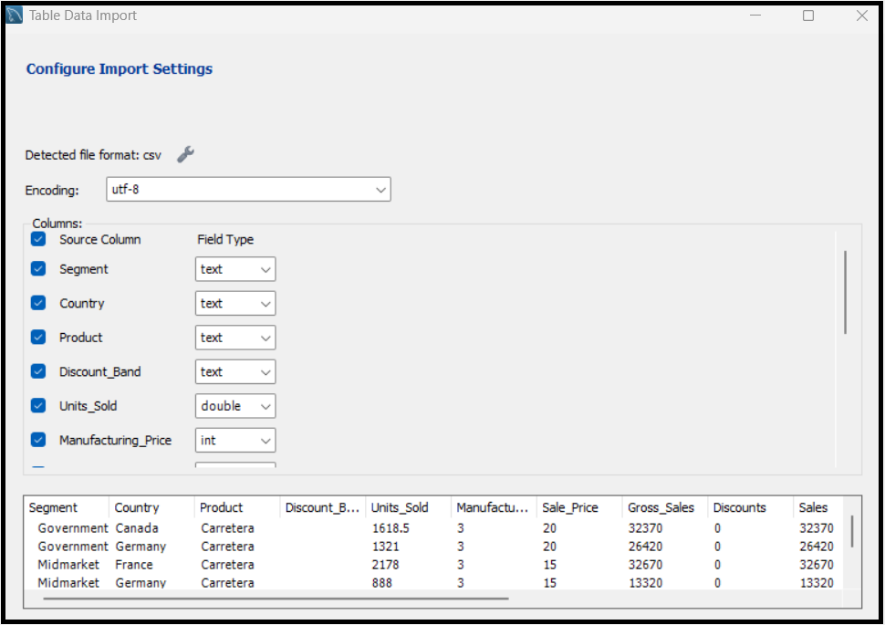
DATABASE SETUP AND SQL OPERATIONS
Database Creation
Database Created
Importing Dataset
Dataset Loaded
Datatype Edition
Showing Database

Slide 9
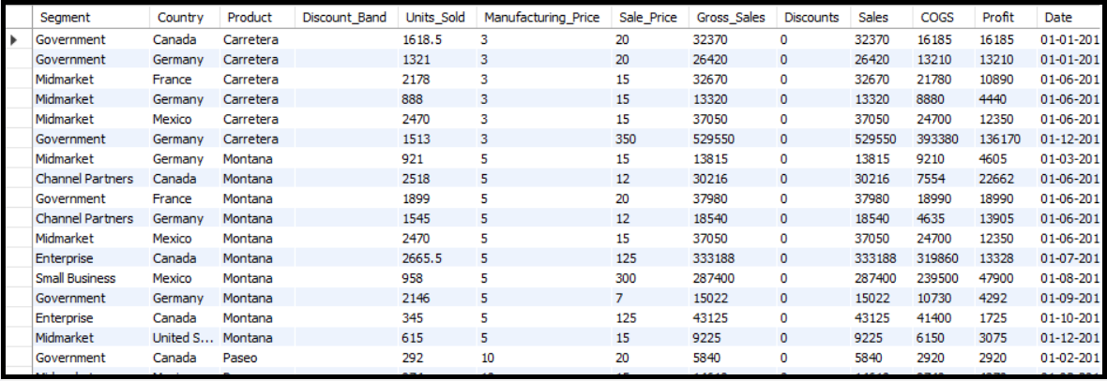
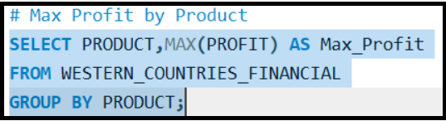
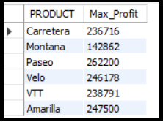
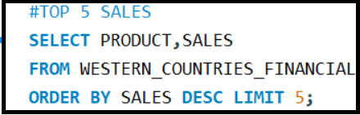
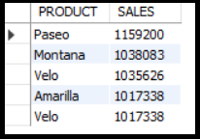
RUNNING QUERIES IN SQL
Input Query
Output Query

Slide 10
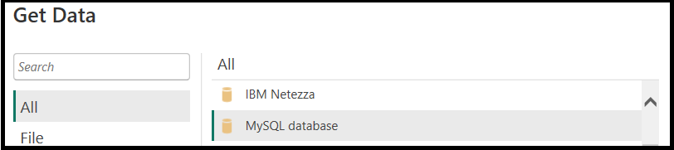
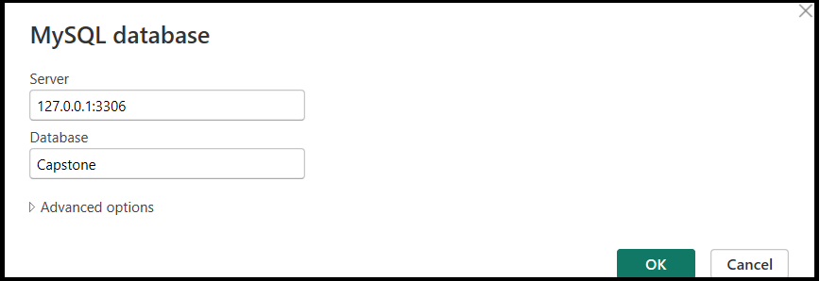
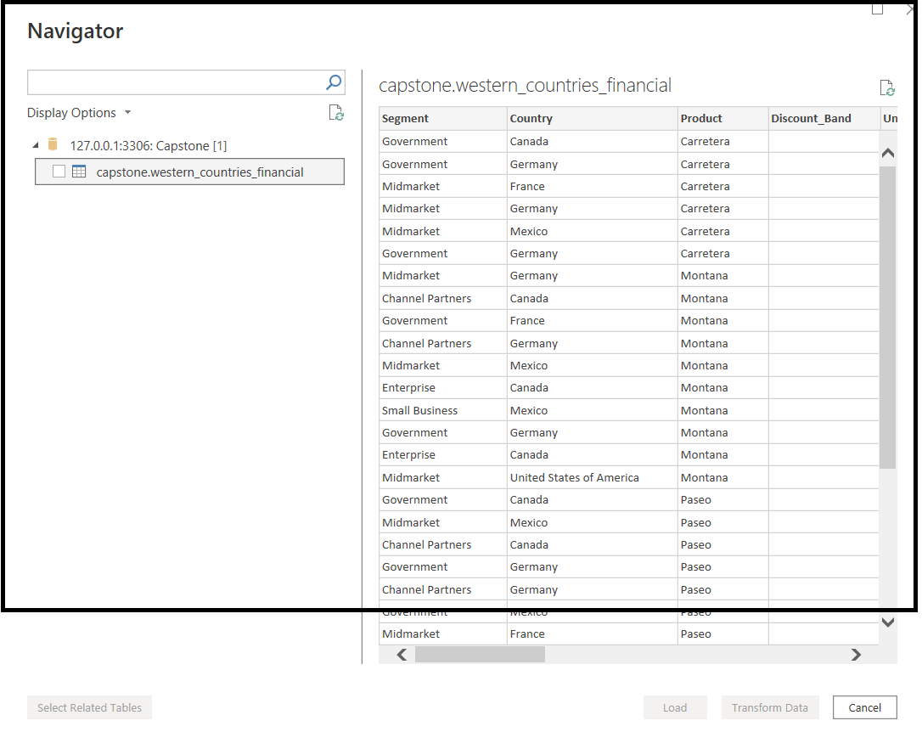
DATA IMPORT TO POWER BI FROM SQL DATABASE
Open Power BI Desktop
Click on Get Data → choose More
Under Database, select MySQL database
Enter:
Server name (127.0.0.1:3306)
Database name (Capstone)
Choose Authentication type:
Typically, Database authentication with username(root) and password
5.Click OK and select the tables or views you want to use
6.Load or transform the data using Power BI’s interface

Slide 11
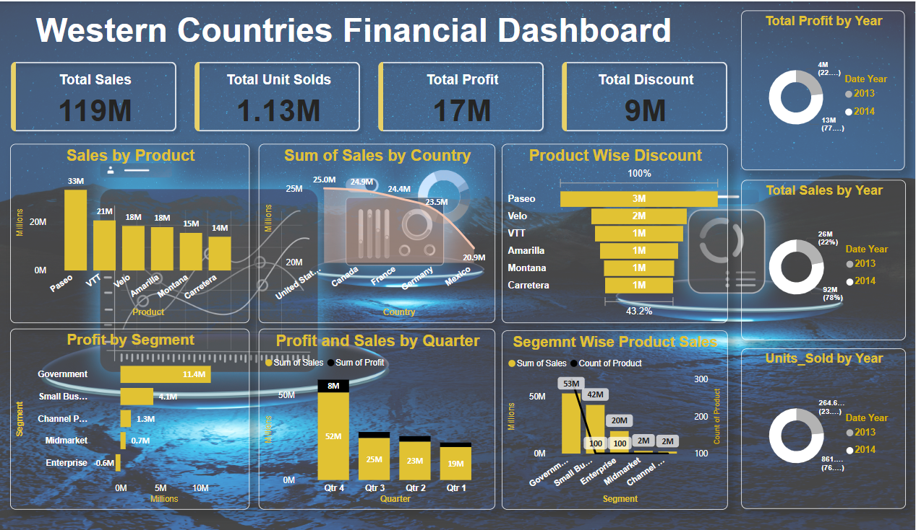
Dashboard

Slide 12
INSIGHTS AND CONCLUSIONS
Top-Selling Product: Paseo recorded the highest sales of $33,011,143.96.
Top Sales Segment: The Government Segment counts for the highest number of sales.
Top Sales Country: USA has the highest number of sales.
Profitability: Paseo yields more profit due to its high sales volume.
Segment Performance: Countries with high sales in the Government Segment also generate higher profits.
Top Profit-Contributing Countries: Francena Germany account for the highest profits.
Best Performing Quarter: Q4 recorded the highest sales and profit.
Business Implication: Focus on high-performing segments and countries while addressing losses in the Enterprise sector.
Loss Area: The Enterprise Sector is experiencing losses.

Slide 13
Thank You

